Slide 1
Contraceptive Methods

Slide 2
Abstinence
1. A behavior that prevents pregnancy
2. Prevents sexually transmitted infection
3. Safe, easy, and convenient

Slide 3
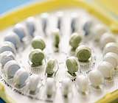
Birth Control Pills
1. Take a pill each day to prevent pregnancy
2. Safe, effective, and convenient
3. Easy to get with a prescription
4. Cost about $15–$50 each month

Slide 4
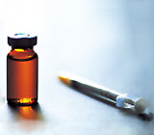
Birth Control Shot
(Depo-Provera)
1. A shot in the arm that prevents pregnancy
2. Safe, effective, and convenient
3. Easy to get with a prescription
4. Lasts for three months
5. Costs $35–$75 per injection, plus any exam fees
http://www.plannedparenthood.org/health-topics/birth-control/birth-control-shot-depo-provera-4242.htm

Slide 5
Birth Control Implant
(Norplant)
1. A matchstick-sized rod that is inserted in the arm to prevent pregnancy
2. Safe, effective, and convenient
3. Must be inserted by a health care provider
Costs between $400 and $800 up front, but lasts up to three years
http://www.plannedparenthood.org/health-topics/birth-control/birth-control-implant-implanon-4243.htm

Slide 6
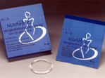
Vaginal Ring
(Nuva Ring)
1. A small ring you put in your vagina once a month for three weeks to prevent pregnancy
2. Safe, effective, and convenient
3. Easy to get with a prescription
4. Costs about $15–$80 a month

Slide 7
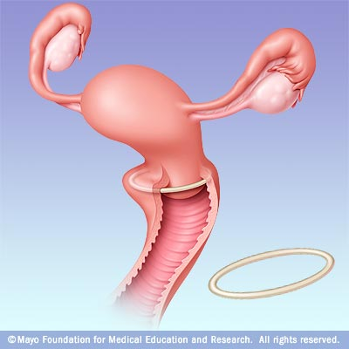

Slide 8
How Does the Vaginal Ring Work?
1. NuvaRing releases hormones. The hormones in NuvaRing are the same hormones as in the birth control pill — estrogen and progestin. 2. The hormones in the ring work by keeping eggs from leaving the ovaries. Pregnancy cannot happen if there is no egg to join with the sperm.
3. Makes the cervical mucus thicker. This keeps sperm from getting to the eggs.
http://www.plannedparenthood.org/health-topics/birth-control/birth-control-vaginal-ring-nuvaring-4241.htm

Slide 9
Birth Control Patch
(Ortho-Evra)
1. A small patch that sticks to your skin to prevent pregnancy
2. Safe, effective, and convenient
3. Easy to get with a prescription
4. Costs about $15–$80 a month
http://www.plannedparenthood.org/health-topics/birth-control/birth-control-patch-ortho-evra-4240.htm

Slide 10
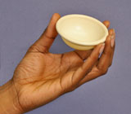
The Diaphragm
1. A shallow silicone cup inserted into the vagina to prevent pregnancy
2. Safe, effective, and convenient
3. Lasts up to two years
Costs about $15–$75
Comes in different
sizes of cervixes.

Slide 11
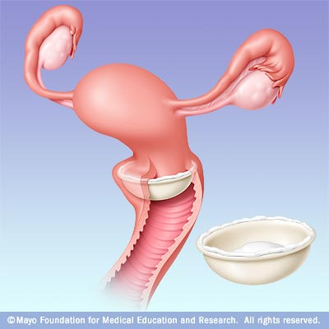

Slide 12
How Does the Diaphragm Work?
1. Diaphragms prevent pregnancy by keeping sperm from joining with an egg. In order to be as effective as possible, the diaphragm must be used with spermicide cream, gel, or jelly.
2. Diaphragms work in two ways: a.The diaphragm blocks the opening to the uterus.
b.The spermicide stops sperm from moving.

Slide 13
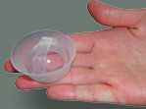
The Cervical Cap
1. A silicone cup inserted into the vagina to prevent pregnancy – reused.
2. Safe, effective, and convenient
3. Lasts for up to two years
Costs about $60–$75
Need a prescription.
What Is the Cervical Cap?
The cervical cap is a silicone cup shaped like a sailor's hat. You insert it into your vagina and over your cervix.

Slide 14
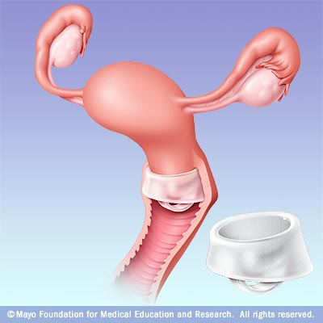

Slide 15
How Does the Cervical Cap Work?
1. The cervical cap prevents pregnancy by keeping sperm from joining with an egg. In order to be as effective as possible, the cervical cap must be used with spermicide cream or jelly.
2. The cap works in two ways: a.The cervical cap blocks the opening to the uterus.
b.The spermicide stops sperm from moving.

Slide 16
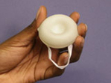
The Sponge
1. A foam sponge inserted into the vagina to prevent pregnancy
2. Safe and convenient
3. Easy to use
4. Costs $9–$15 for a package of three sponges

Slide 17
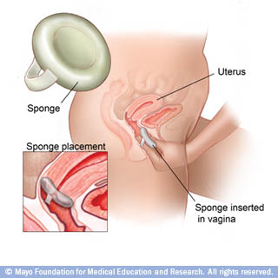

Slide 18
How Does the Sponge Work?
1. The sponge prevents pregnancy by keeping sperm from joining with an egg. It works in two ways:
2. The sponge covers the cervix and blocks sperm from entering the uterus.
3. The sponge also continuously releases a spermicide that keeps sperm from moving.

Slide 19
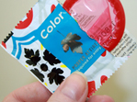
Condoms
1. Worn on the penis
2. Made of latex or plastic
3. Prevent pregnancy and STI’s
4. Can be used with another form of birth control for extra protection
5. Can be used for vaginal, anal, or oral sex
6. Safe, effective, and easy to get
7. Cost about $1 each, but are sometimes available for free

Slide 20
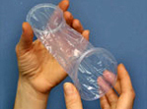
Female Condoms
1. A pouch inserted into the vagina to prevent pregnancy
2. Reduces the risk of STI’s
3. Can be used for vaginal and anal intercourse
4. Safe, effective, and convenient
5. Easy to get
6. Cost about $4 each

Slide 21
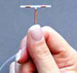
The IUD
1. Small, "T-shaped" device inserted into the uterus to prevent pregnancy
2. Safe, effective, and long lasting
3. Must be inserted by a health care provider
4. Costs between $500 and $1,000 up front, but lasts up to 12 year
http://www.plannedparenthood.org/health-topics/birth-control/iud-4245.htm

Slide 22
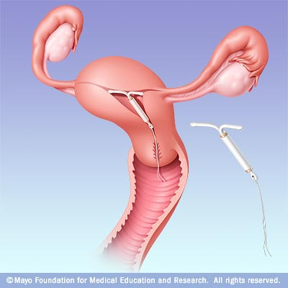

Slide 23
Morning-After Pill
(Emergency Contraception)
1. Birth control you can use to prevent pregnancy up to five days (120 hours) after unprotected sex
Two kinds of emergency contraception —
a. morning-after pill
b. IUD insertion
3. Safe and effective
4. Available at health centers and drugstores
5. Costs vary from $10 to $70 for the morning- after pill and up to $500 for IUD insertion

Slide 24
What Is the Morning-After Pill
1. Emergency contraception is a safe and effective way to prevent pregnancy after unprotected intercourse.
2. There are two kinds of emergency contraception:
a. a pill, commonly called the morning- after pill. The brand names of the morning-after pill are ella, Next Choice, and Plan B One-Step.
b. ParaGard IUD insertion
3. Both kinds of emergency contraception can be used up to five days (120 hours) after unprotected intercourse.

Slide 25
You may want to use the Morning- After Pill: 1. The condom broke or slipped off
2. You forgot to take your birth control pills, insert your ring, or apply your patch.
3. Your diaphragm or cap slipped out of place,
4. You miscalculated your "safe" days.
5. He didn't pull out in time.
6. You weren't using any birth control.
7. You were forced to have unprotected vaginal sex.

Slide 26
Morning-After Pill:
1. Both types of emergency contraception work by keeping a woman's ovaries from releasing eggs — ovulation. Pregnancy cannot happen if there is no egg to join with sperm.
2. You might have also heard that the morning-after pill causes an abortion. But that's not true. The morning- after pill is not the abortion pill. Emergency contraception is birth control, not abortion.

Slide 27
Withdrawal
1. Withdrawal is also called coitus interruptus or the "pull out method"
2. Where the man takes his penis out of the vagina prior to ejaculation
3. Safe, easy, and convenient

Slide 28
Vasectomy
1. Sterilization for men that prevents pregnancy
2. Safe and effective
3. Costs $350 to $1,000
4. Meant to be permanent
http://www.youtube.com/watch?v=whwmCbeYU1I
http://www.plannedparenthood.org/health-topics/birth-control/vasectomy-4249.htm

Slide 29
Sterilization for Women
(Tubal Ligation)
1. Surgery that prevents pregnancy
2. Safe and highly effective
3. Costs between $1,500 and $6,000
4. Meant to be permanent
http://www.youtube.com/watch?v=GxRJH2f--P0
http://www.plannedparenthood.org/health-topics/birth-control/sterilization-women-4248.htm

